Slide 1


Crop Production in India
India is a land of diverse agricultural practices, with a rich tapestry of crop production that spans the length and breadth of the country. From the lush rice paddies of the East to the vibrant vegetable gardens of the South, the country's agricultural landscape is a testament to the resilience and ingenuity of its farmers. This section will provide an overview of the crop production landscape in India, highlighting the key challenges, opportunities, and the role of data-driven solutions in optimizing agricultural practices.
by Jayent Singh Parihar

Slide 2
Introduction
Diverse Agro-climatic Zones
Smallholder Farming Dominance
Importance to the Economy
India's vast geographical expanse encompasses a wide range of agro-climatic zones, each with its unique soil, rainfall patterns, and temperature profiles. This diversity allows for the cultivation of a vast array of crops, from the tropical fruits of the South to the hardy cereals of the North.
The Indian agricultural landscape is predominantly characterized by smallholder farms, with the majority of farmers operating on less than 2 hectares of land. This presents both challenges and opportunities in terms of productivity, resource utilization, and market access.
Agriculture remains a crucial sector of the Indian economy, contributing significantly to the country's GDP and employing a large portion of the population. Optimizing crop production is, therefore, a vital component of India's economic and social development.

Slide 3

Problem Statement
1
Yield Gaps
2
Climate Change Impacts
Despite the country's agricultural prowess, there exist significant yield gaps between the potential and the actual yields of various crops. Bridging these gaps is crucial for enhancing food security and farmer livelihoods.
Climate change-induced shifts in temperature, rainfall patterns, and the frequency of extreme weather events pose a growing threat to crop production, necessitating the development of resilient agricultural practices.
3
Resource Utilization
4
Market Volatility
Efficient utilization of limited natural resources, such as water and arable land, is a pressing concern as the population grows and the demand for food increases.
Crop production is often subject to market fluctuations, which can impact farmer incomes and the overall food supply chain. Mitigating these challenges requires a comprehensive understanding of the market dynamics.

Slide 4
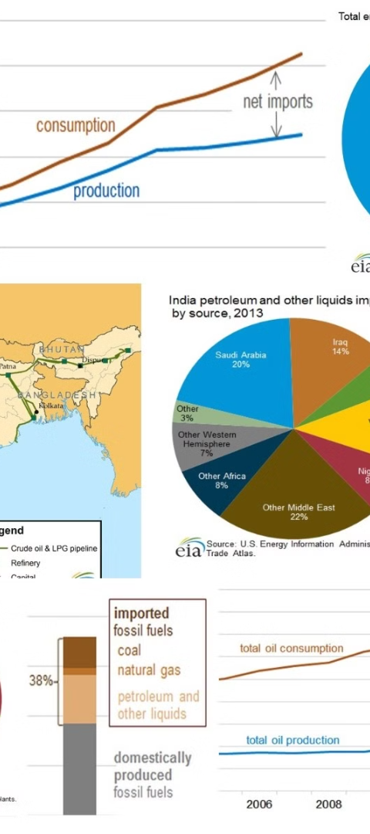
Approach
1
Data Collection
Gathering comprehensive and reliable data on crop production, including yields, acreage, and other relevant factors, is the foundation for a robust analysis.
2
Data Preprocessing
Cleaning, transforming, and integrating the data from various sources to ensure data quality and consistency is a crucial step in the analysis process.
3
Exploratory Data Analysis
Conducting a thorough EDA to uncover patterns, trends, and insights within the data is essential for identifying the key drivers of crop production and informing the development of data-driven solutions.

Slide 5
Structure of Dataset
Crop-specific Data
Regional Variations
The dataset includes detailed information on the production, yield, and acreage of major crops grown in various regions of India, allowing for a comprehensive analysis of crop-specific trends and patterns.
The data is further segmented by states and districts, enabling the analysis of regional variations in crop production and the identification of potential opportunities for targeted interventions.
Temporal Trends
Supplementary Data
The dataset spans multiple years, providing insights into the temporal dynamics of crop production and the impact of factors such as weather, market conditions, and policy changes over time.
The dataset is complemented by additional information on relevant factors, such as soil characteristics, irrigation availability, and infrastructure, allowing for a more holistic understanding of the crop production ecosystem.

Slide 6
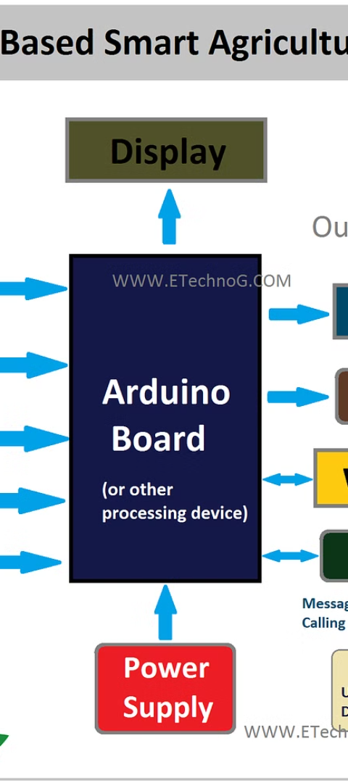



Architecture
Data Sources
The analysis draws upon a diverse range of data sources, including government databases, satellite imagery, and real-time sensor networks, to capture the multifaceted aspects of crop production.
Data Processing
The data is processed using a combination of cloud-based computing platforms and advanced analytics tools to efficiently handle the large volumes of data and enable rapid insights generation.
Visualization and Reporting
The insights derived from the data analysis are presented through interactive dashboards and customized reports, empowering stakeholders to make informed decisions and drive sustainable agricultural practices.

Slide 7




Exploratory Data Analysis (EDA) Report
Yield Trends
Climate Impacts
Market Dynamics
Technology Adoption
The EDA highlighted the shifting patterns in crop yields, with some regions experiencing significant improvements while others faced stagnation or decline. This information is crucial for targeting interventions and resource allocation.
The analysis revealed the profound influence of climate factors, such as rainfall and temperature, on crop production, underscoring the need for climate-smart agricultural practices and the development of resilient crop varieties.
The EDA uncovered insights into the complex market dynamics, including price fluctuations, supply-demand imbalances, and the impact of policy decisions on crop production and farmer livelihoods.
The data analysis highlighted the potential for technology-driven solutions, such as precision farming and predictive analytics, to bridge the yield gaps and enhance the efficiency of agricultural practices.

Slide 8
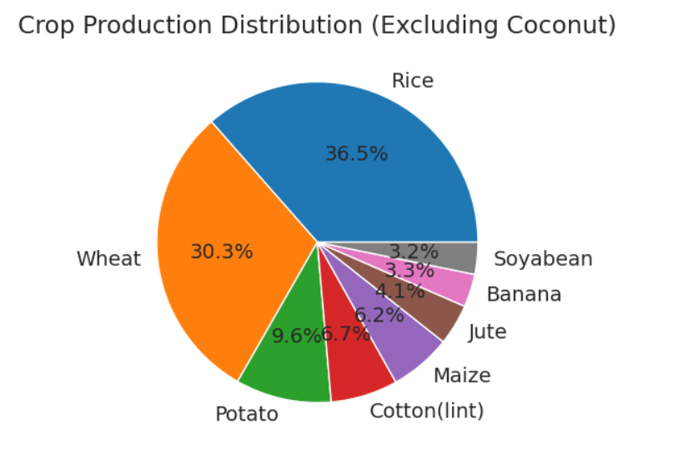
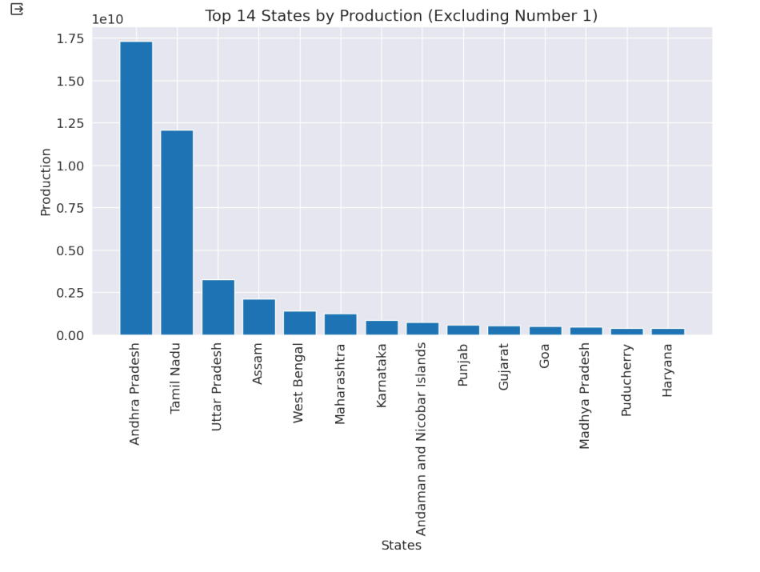
Exploratory Data Analysis (EDA) Report

Slide 9
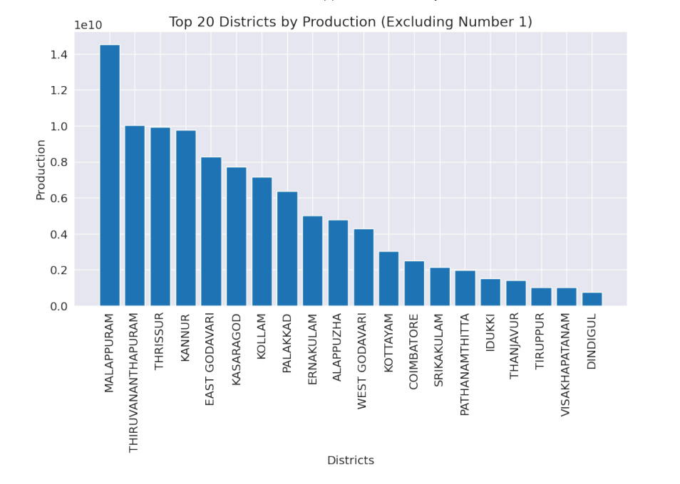
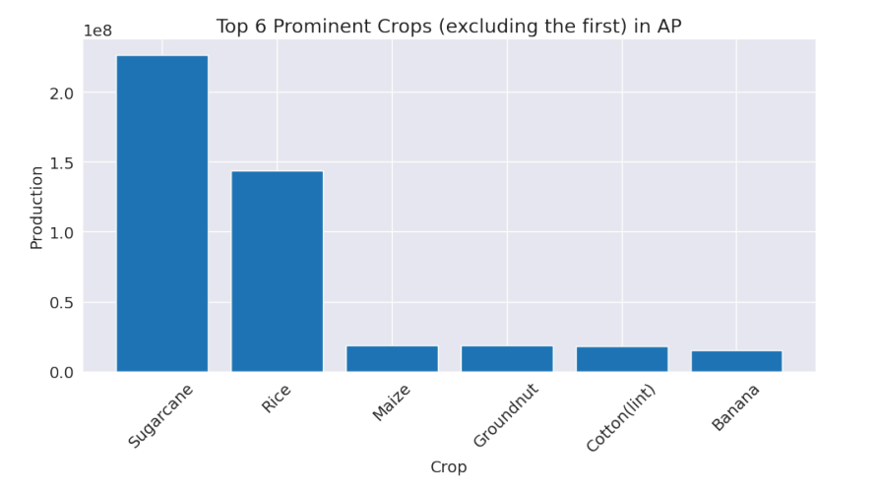
Exploratory Data Analysis (EDA) Report

Slide 10
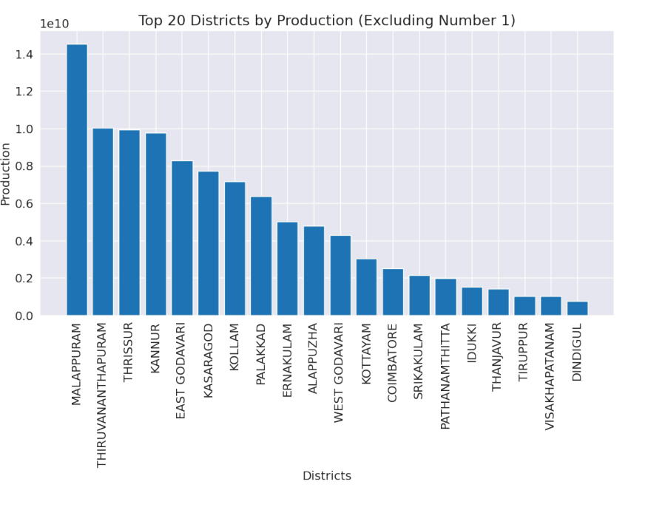
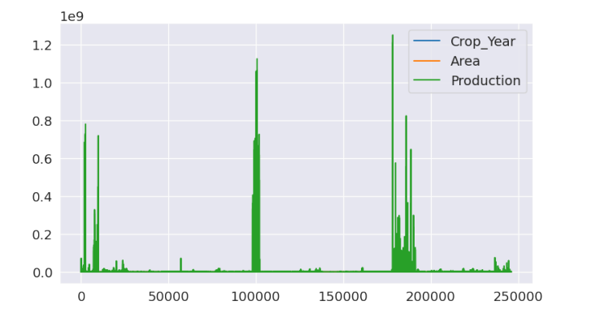
Exploratory Data Analysis (EDA) Report

Slide 11
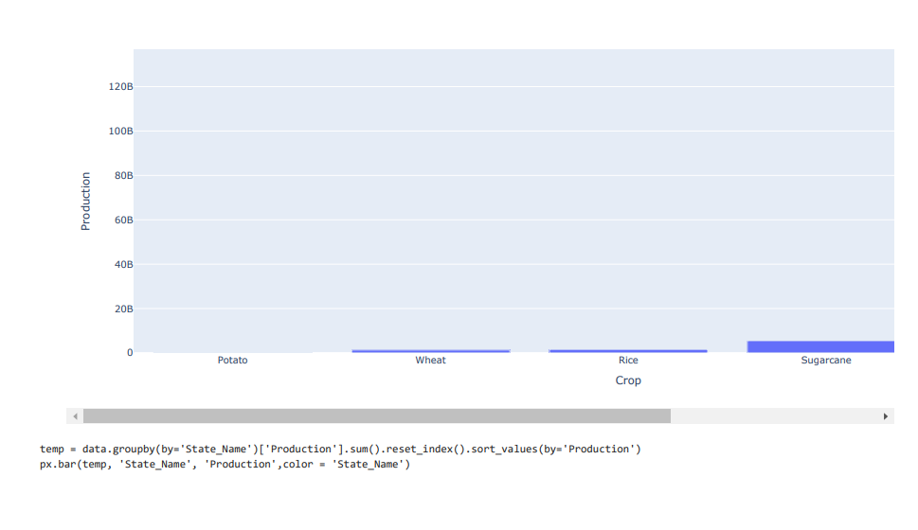
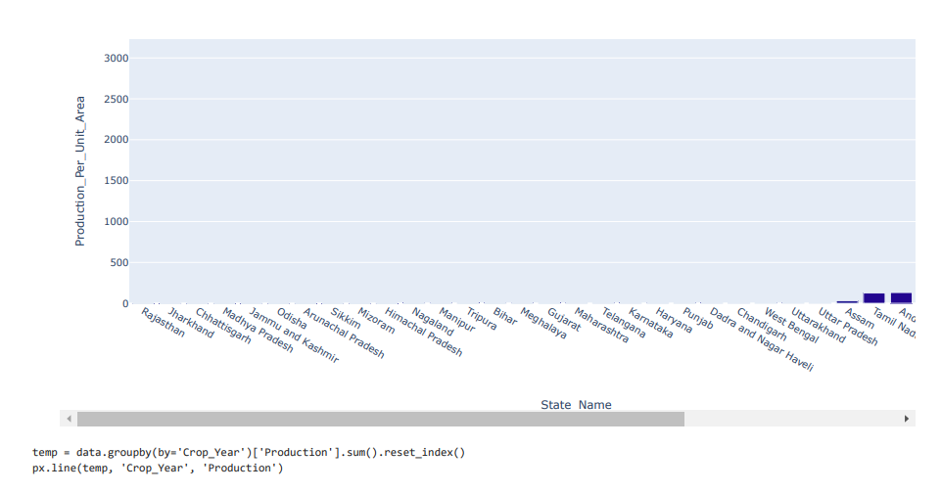
Exploratory Data Analysis (EDA) Report

Slide 12
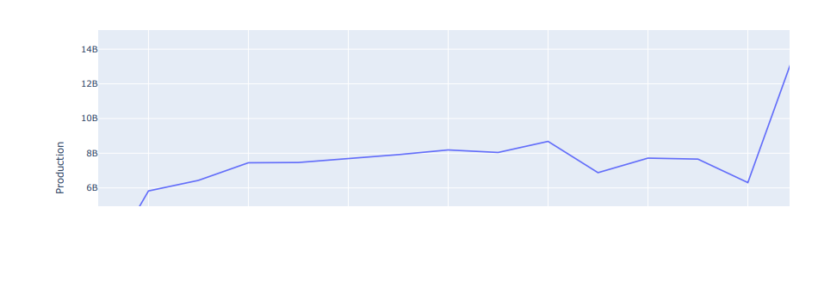
Exploratory Data Analysis (EDA) Report

Slide 13
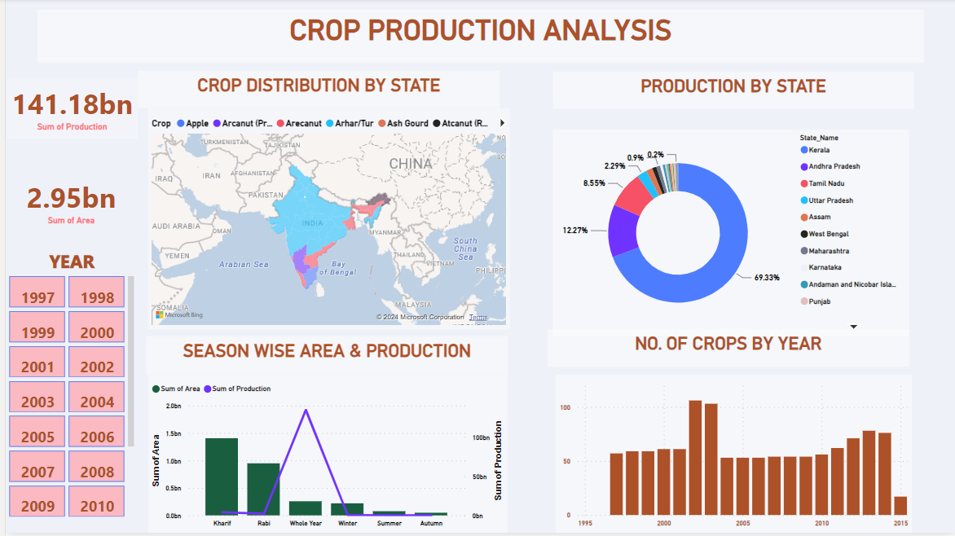
Dashboard

Slide 14
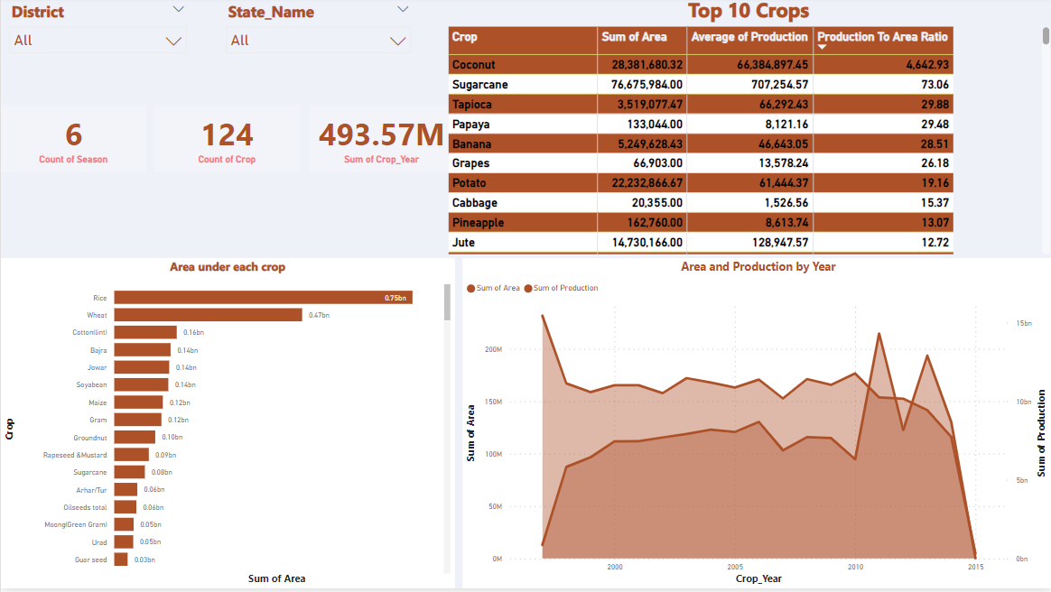
Dashboard

Slide 15
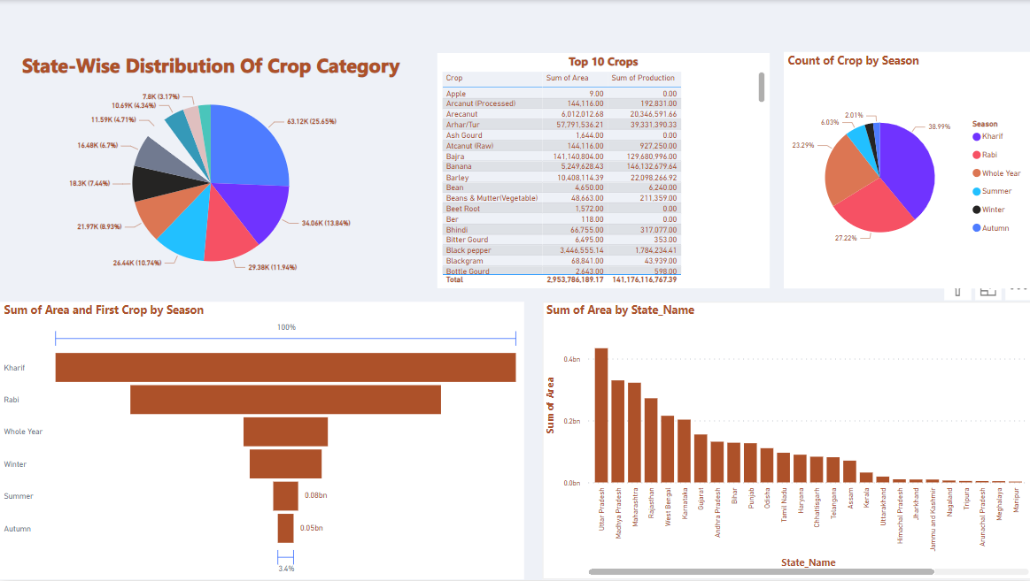
Dashboard

Slide 16
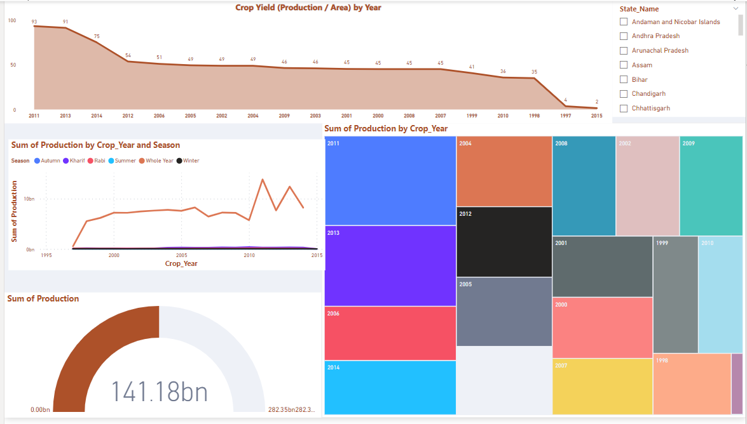
Dashboard

Slide 17
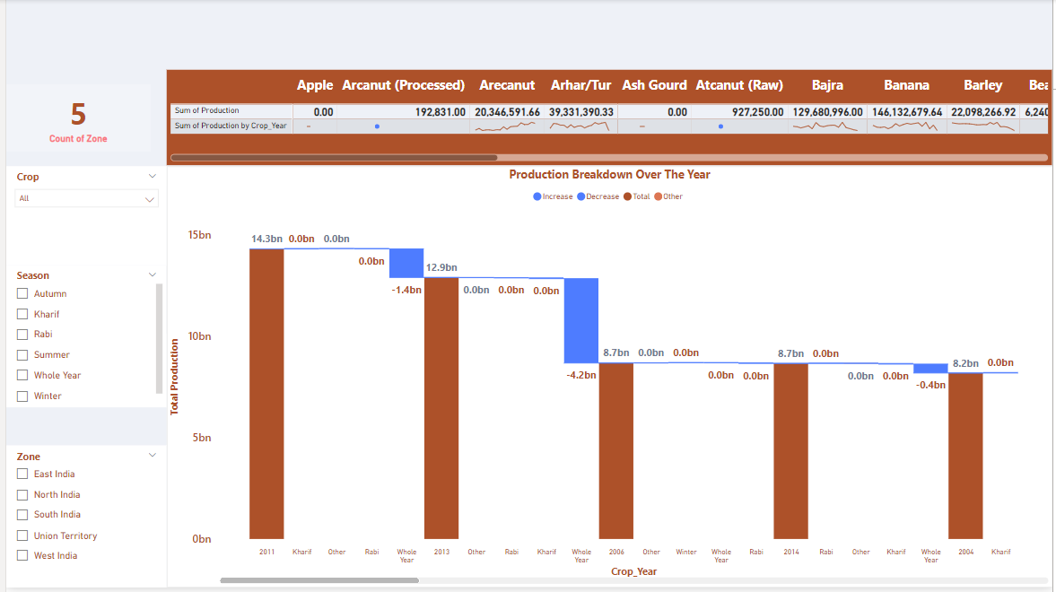
Dashboard

Slide 18

THANK YOU
This comprehensive analysis of crop production in India has highlighted the diverse challenges and opportunities within the agricultural sector. By leveraging data-driven insights and innovative solutions, we can work towards enhancing food security, improving farmer livelihoods, and promoting sustainable agricultural practices that benefit both the economy and the environment. We express our gratitude to the hardworking farmers and agricultural communities who are the backbone of India's food production system.

